Slide 1


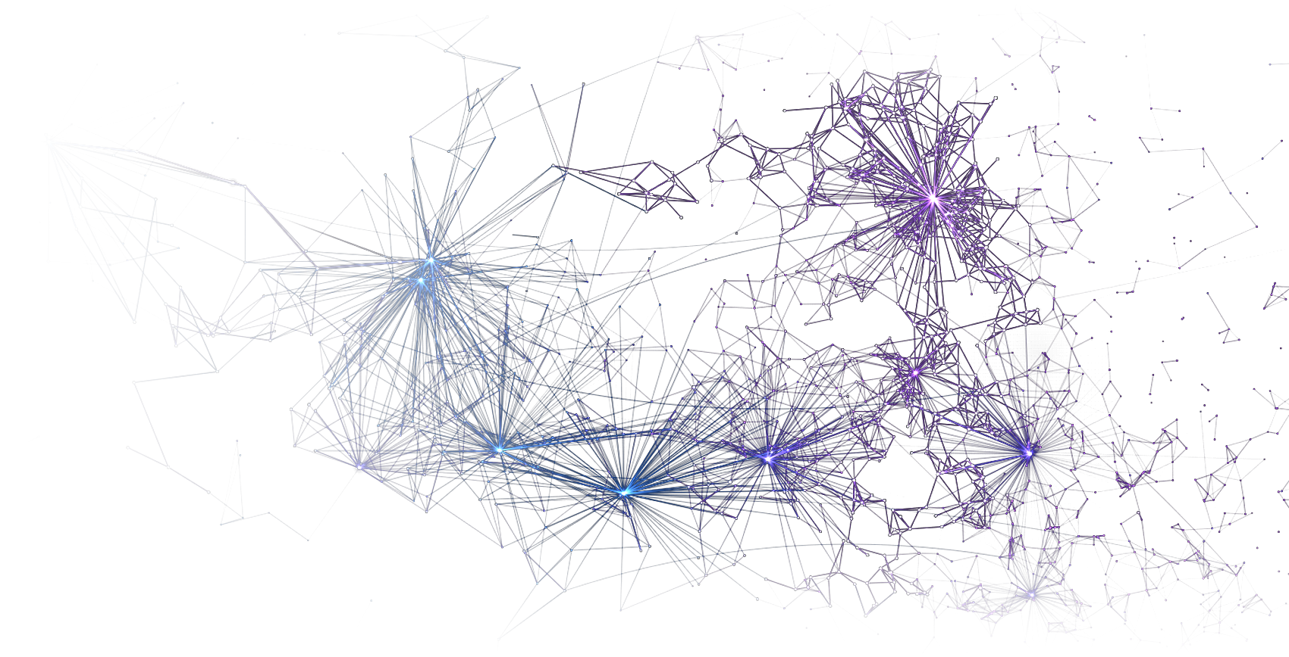
FINAL PROJECT · YSD BATCH 05 · AI
Sift.
An AI recruiting platform that reads every CV,
interviews every candidate, and shows its evidence.
AI voice interviewer
Face identity check
Explainable scoring
Kaji Sadman Sakib · 30234
Notes:
Introduce yourself: Kaji Sadman Sakib, ID 30234, YSD Batch 05, AI track at BJIT Academy. Sift is an AI recruiting platform. The image on the right is the live neural avatar of Sift's AI interviewer.

Slide 2

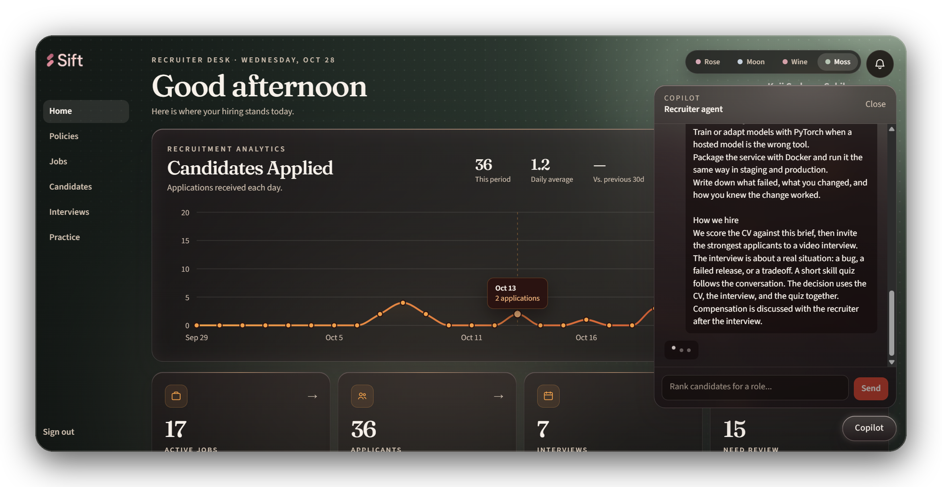
02 · PROJECT OVERVIEW
One desk for the whole hiring pipeline
Sift is a recruiter’s desk where every step of hiring runs through one pipeline, and every score comes with its reasons.
A role is written once, from the company’s own policy. From then on, CVs, interviews, quizzes, and reports all measure against the same locked checklist.
A recruiter can run the interview with a live transcript and copilot, or let Sift’s AI interviewer run it on its own.
17
36
7
Recruiter desk · live analytics, with the copilot drafting a role brief
ACTIVE ROLES
APPLICANTS
INTERVIEWS
SIFT
02 / 19
Notes:
Purpose and background: hiring teams receive more applications than they can read, and interviews are inconsistent. Sift is the single desk that runs the whole pipeline. The numbers are from the running system.

Slide 3

03 · PROBLEM STATEMENT
Hiring is slow, inconsistent, and easy to fake
01
Too many CVs to read
02
Every interview is different
Recruiters skim and filter by keyword. Strong people are missed, and nobody can explain why one CV beat another.
Questions change with the interviewer and the day, so two candidates are never measured on the same scale.
03
Claims go unchecked
04
Remote calls invite impersonation
What the CV says and what the candidate says on the call are never compared side by side.
In a video interview, nothing checks that the person on camera is the person who applied.
Why it matters A bad hire is expensive, and a decision that cannot be explained cannot be defended.
SIFT
03 / 19
Notes:
The four problems: volume, inconsistency, unverified claims, and identity. Each maps to a part of Sift.

Slide 4

04 · PROJECT OBJECTIVES
What Sift sets out to do
GOAL
EXPECTED OUTCOME
Ground every role in policy
A brief and a 10-question checklist drawn from indexed company policy, locked before applications open.
1
Screen fairly at scale
Every CV scored against the same checklist, with the supporting line quoted from the CV.
2
Interview without a bottleneck
An AI interviewer that runs the call on its own, or a live transcript and copilot for a recruiter.
3
Verify the person and the claims
A consented face match against the CV photo, and spoken answers checked against CV claims.
4
Decide with one explainable score
Master assessment from CV (37.5%) and interview (62.5%), plus a skill quiz, ranked for approval letters.
5
SIFT
04 / 19
Notes:
Five goals, each with a measurable outcome. The interview weighting is the real formula in the master assessment.

Slide 5

05 · KEY FUNCTIONALITIES
Everything a hiring team needs, in one pipeline
Policy-grounded job drafting
CV intake by upload or email
Evidence-based scoring
The copilot writes the brief and ten checklist questions from indexed policy.
PDF or DOCX from the desk or a Gmail inbox, with OCR when text is missing.
Each checklist item marked met, partial, or missing, with the CV line quoted.
Calendar-aware invitations
AI voice interviewer
INNOVATION
Face identity check
INNOVATION
Top candidates get a private link and a free interview slot.
Runs the whole call by voice, then writes the reports.
Consented match of the live camera against the CV photo.
Live transcript & copilot
Skill quiz & five reports
Recruiter copilot
Messenger-style transcript, coverage gaps, and a suggested next question.
Q&A, CV claims, interview score, quality, and a master assessment.
Ask in plain words: rank, compare, open a candidate, or draft a role.
SIFT
05 / 19
Notes:
Nine capabilities. The two highlighted are the innovation: the AI interviewer and the identity check. The next two slides go deeper on them.

Slide 6


INNOVATION · THE AI INTERVIEWER
An interviewer that
runs the call on its own
Talks in real time Joins the candidate’s video room as a voice with a living neural avatar.
Asks what the role needs Questions come from the locked checklist and the recruiter’s question bank.
Listens like a person Waits for real silence, follows up once on a thin answer, answers “can you hear me?”
Never stalls If the language model is slow, it continues from the checklist instead of going quiet.
Finishes the job Hands over to the skill quiz, closes the call, and writes all five reports.
Groq Whisper · hears
Gemini · thinks
Orpheus · speaks
Live AI interviewer room · the avatar reacts as it speaks
SIFT
06 / 19
Notes:
This is the show-stopper. When no recruiter is in the room, Sift's own interviewer joins the LiveKit call. Groq Whisper hears the candidate, Gemini plans the next line from the checklist, and the Orpheus voice speaks it. It waits for the candidate to finish, follows up on thin answers, never goes silent if the model is slow, then runs the quiz, ends the call, and writes the reports. If possible, show it live here.

Slide 7
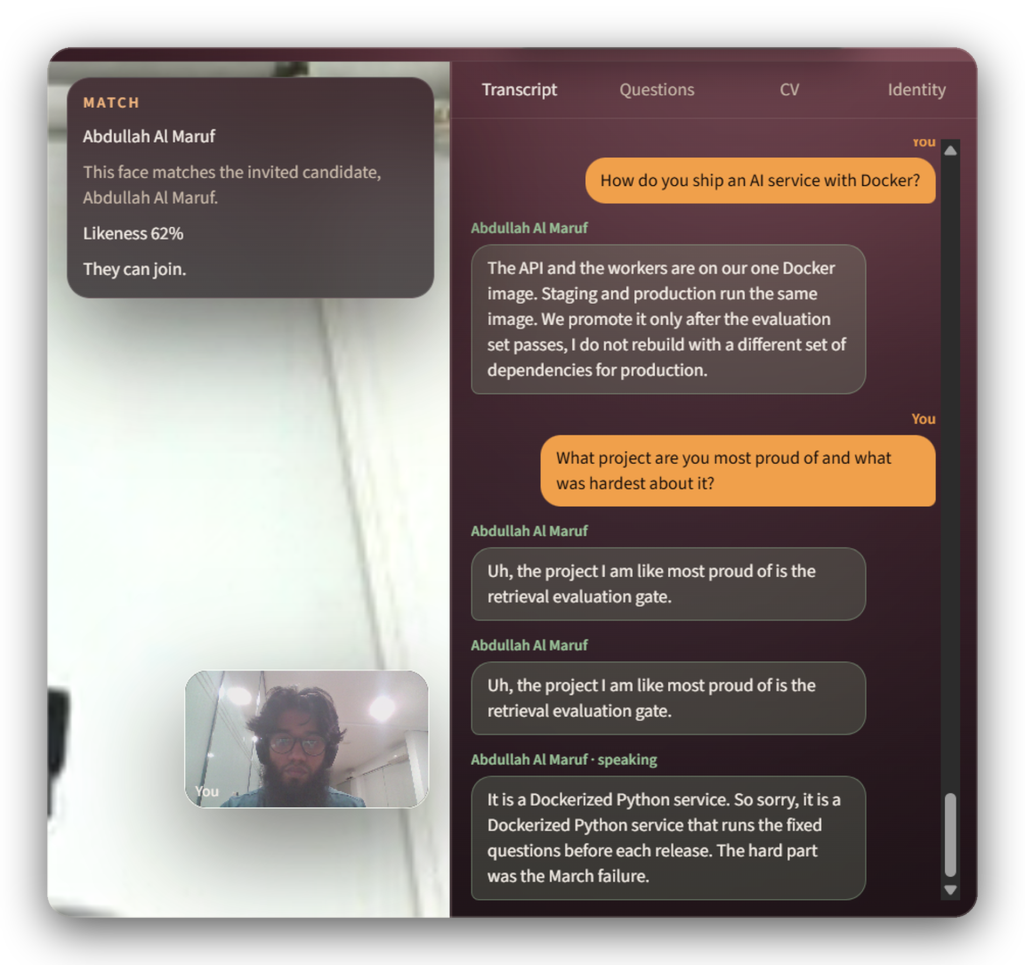
INNOVATION · THE TRUST LAYER
Is this the right person,
and is it true?
Face identity check
After the candidate agrees, three camera frames are matched against the photo on their CV. A recruiter can still let them in.
Claims cross-check
Every spoken answer is compared with what the CV claims. Contradictions are flagged with the checklist item they touch.
Messenger-style transcript
Recruiter on the right, candidate on the left, saved line by line for every report.
Likeness 62% · they can join
SIFT
07 / 19
Notes:
The second innovation is trust. The face check only runs after consent, compares three frames with the CV photo using InsightFace, and the recruiter keeps the final say. The transcript feeds the CV-claims report, which compares what was said with what the CV claims. The screenshot is the real call with Abdullah Al Maruf: 62% likeness, admitted.

Slide 8
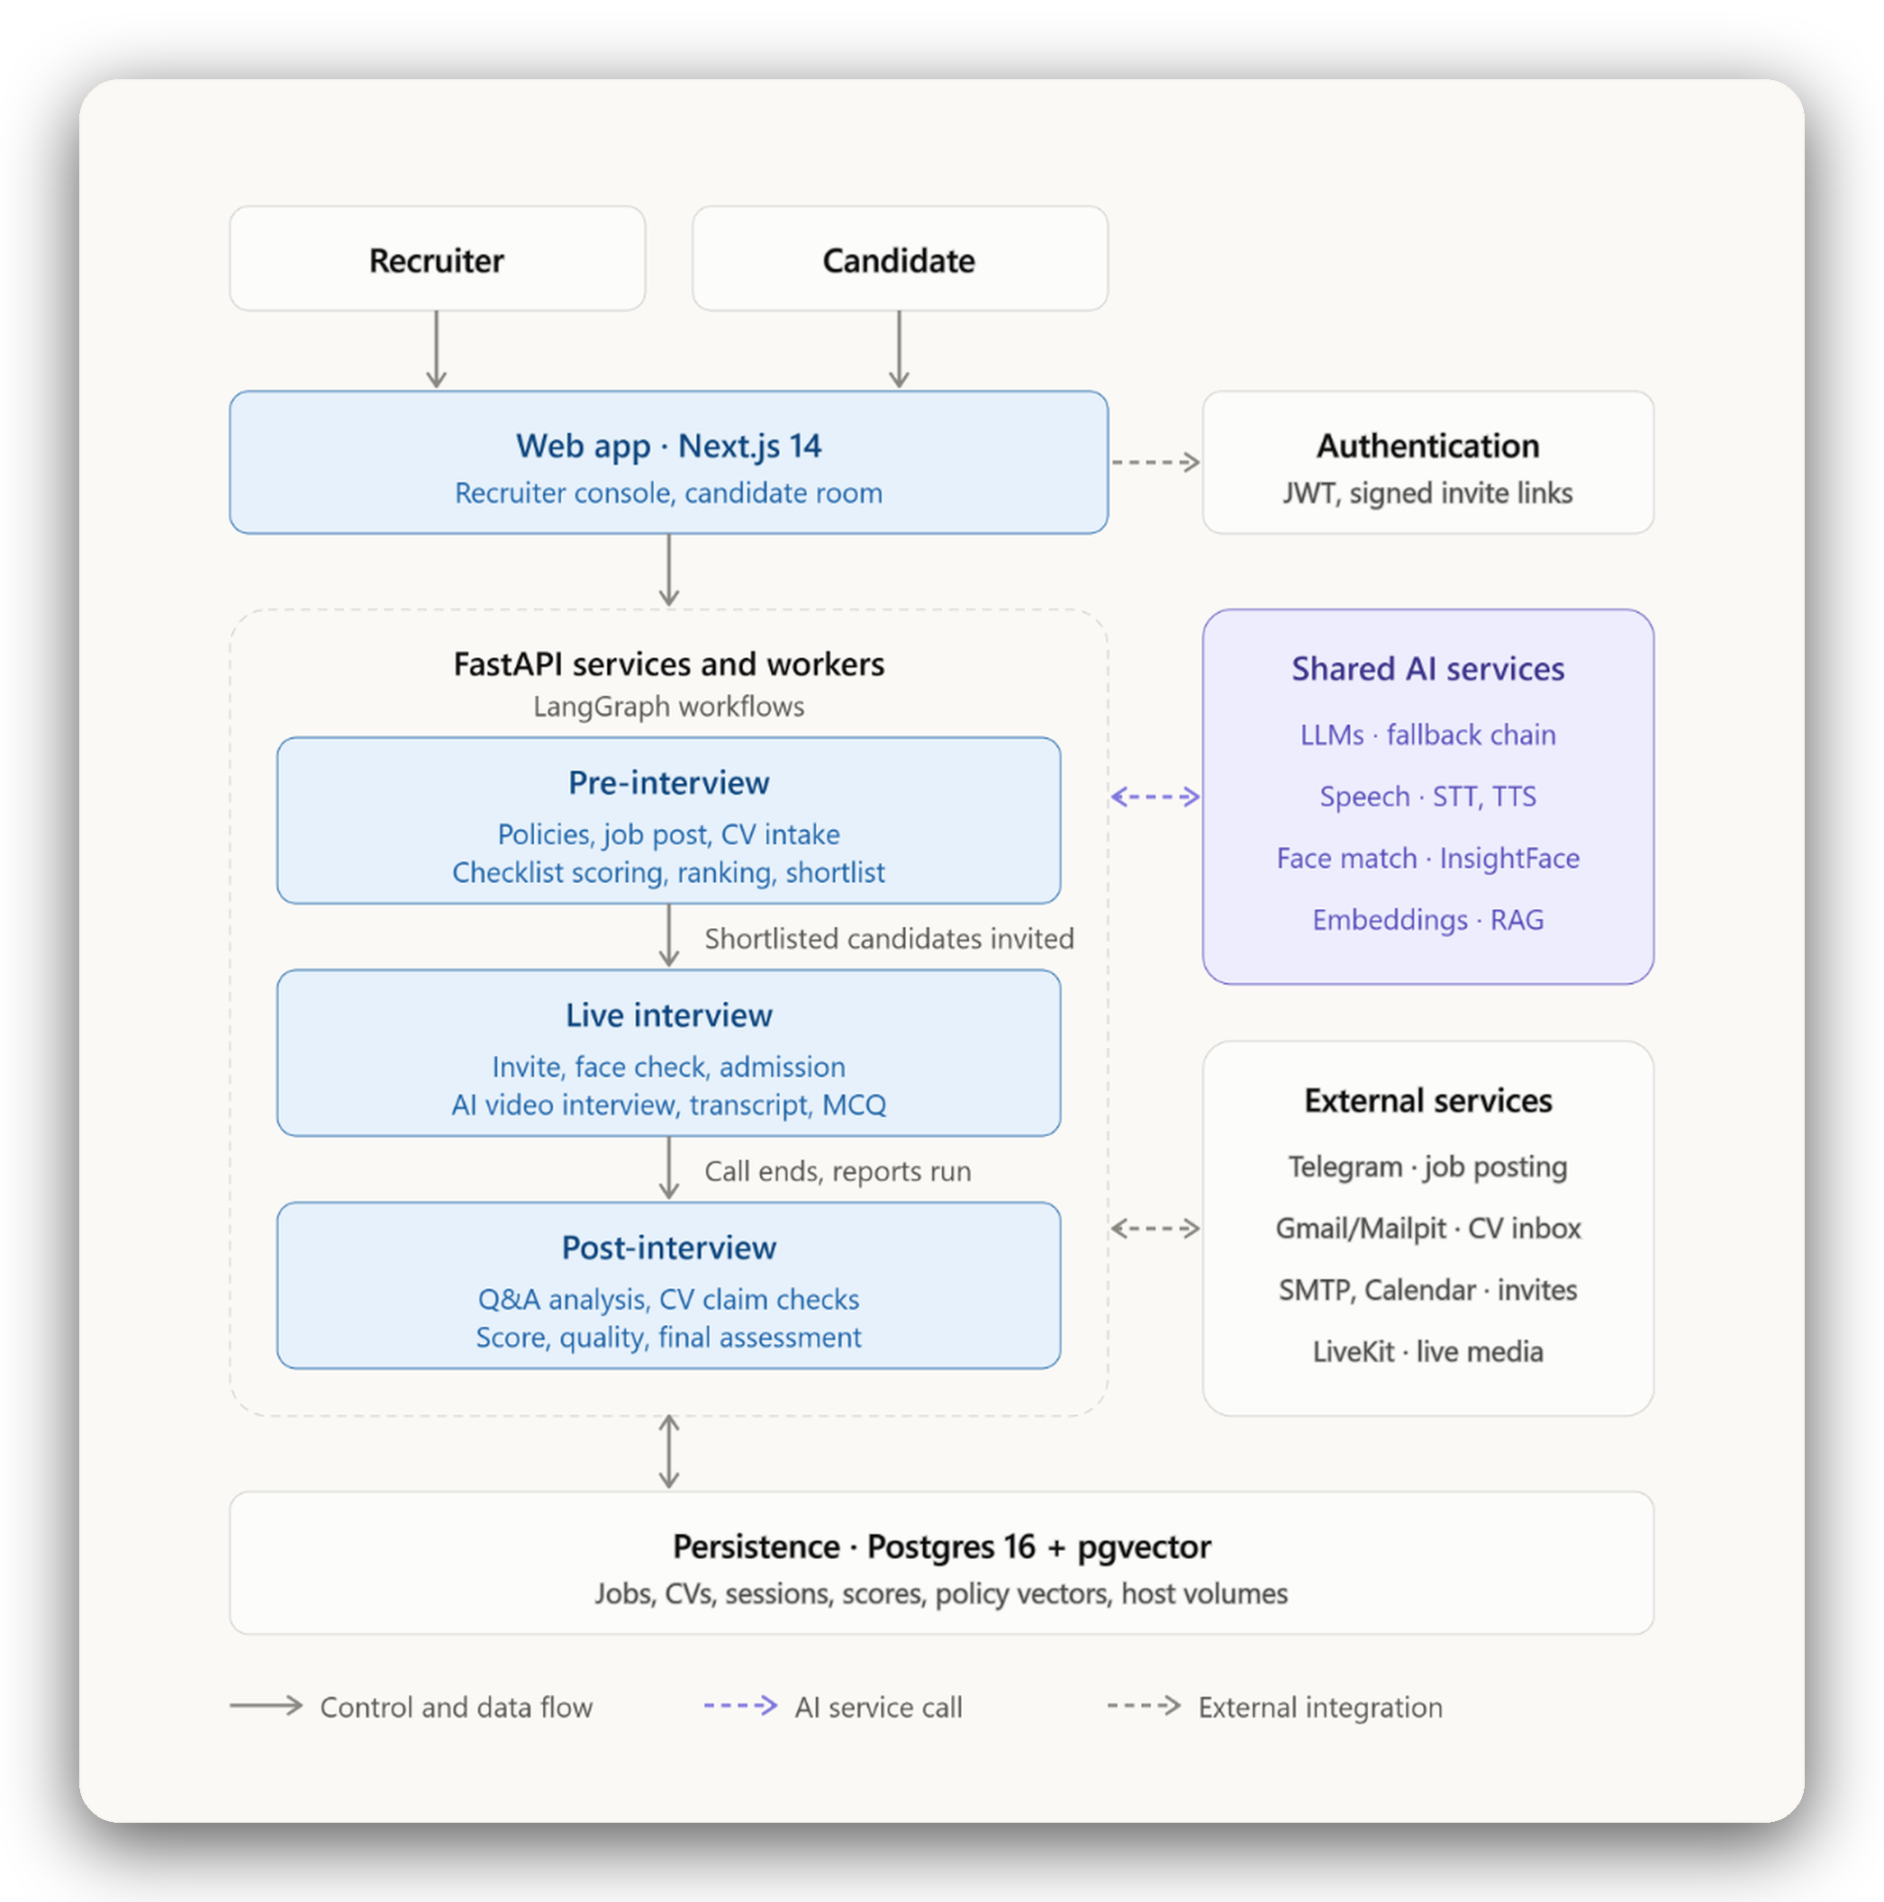
06 · SYSTEM ARCHITECTURE
The big picture
Two people, one web app, and one backend that carries every candidate through three stages.
1
Pre-interview
Policy, job post, and CV intake, then checklist scoring, ranking, and the shortlist.
2
Live interview
Invitation, face check, and admission, then the AI video interview, transcript, and quiz.
3
Post-interview
Q&A analysis and CV claim checks, then the interview score, quality, and final assessment.
Shared by every stage one AI layer (language models, speech, face match, policy search) and one Postgres 16 + pgvector store.
SIFT
08 / 19
Notes:
Start with the big picture. Recruiters and candidates use the same Next.js web app, signed in with a JWT or a signed invite link. Behind it, FastAPI services and workers run LangGraph workflows in three stages: pre-interview, live interview, and post-interview. Every stage calls the same shared AI services and reads and writes one Postgres database with pgvector. External services handle job posting, the CV inbox, invitations, and live media.

Slide 9

06 · SYSTEM ARCHITECTURE
How the pieces fit
Recruiter
Frontend
Backend API
AI components
Browser desk, signed in
Next.js 14 · React
TypeScript · Tailwind
LiveKit client
for video and audio
Three.js neural avatar
FastAPI · /api/v1
JWT sessions · Pydantic v2
LangGraph job drafting
LLM router: Claude → Gemini → Ollama
Groq Whisper · Orpheus voice
InsightFace face match
FastEmbed + pgvector policy RAG
Candidate
Private invite link
Workers
Data
Tailscale Funnel
AI interviewer agent
Live transcriber agent
Inbox worker · MCP publisher
PostgreSQL 16 + pgvector · Redis
Public HTTPS into
the app and API
External services
Gmail · Calendar · Mailpit · Telegram
LiveKit Cloud
WebRTC media for every interview room. The AI interviewer and the transcriber join the room as participants. coturn relays media through firewalls.
SIFT
09 / 19
Notes:
Left to right: people reach the Next.js frontend through public HTTPS. The FastAPI backend owns auth, jobs, scoring, and reports. Workers run the AI interviewer, the transcriber, and inbox intake. AI calls go through one router with fallbacks. Video and audio flow through LiveKit Cloud, where the agents join as participants. Postgres with pgvector stores everything, including policy embeddings.

Slide 10
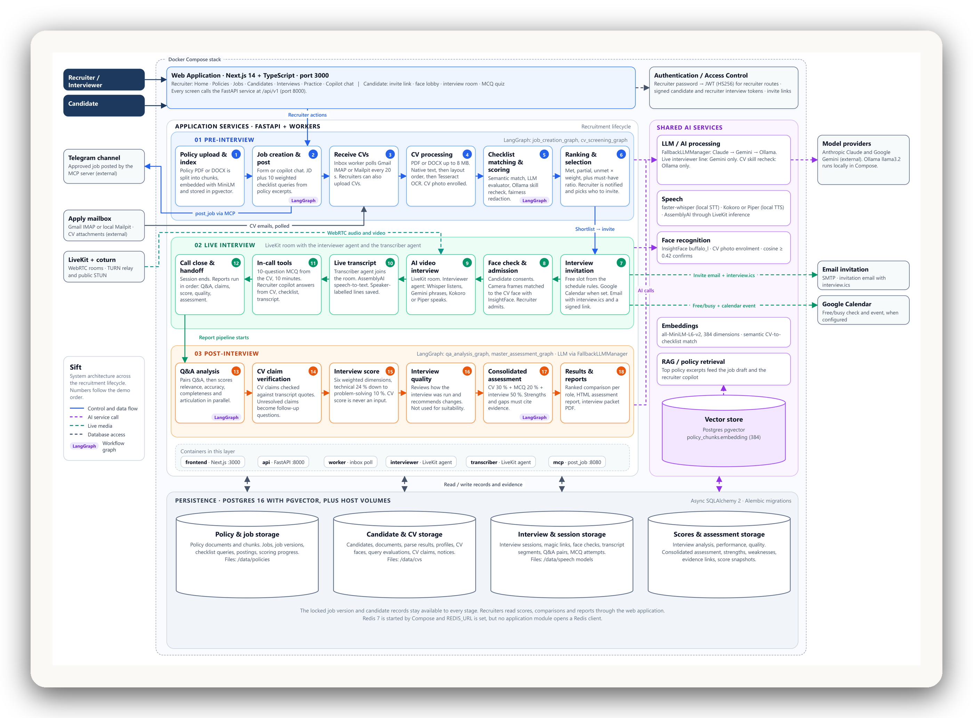
06 · SYSTEM ARCHITECTURE
Every step,
end to end
18
STEPS
numbered in the order of the demo
3
STAGES
pre-interview, live, post-interview
4
LANGGRAPH WORKFLOWS
job creation, CV screening, Q&A analysis, master assessment
6
APP CONTAINERS
frontend, api, worker, interviewer, transcriber, mcp
Solid lines carry control and data. Violet dashes are AI calls, green dashes are live media.
SIFT
10 / 19
Notes:
The full blueprint, with every step numbered in demo order. Pre-interview, steps 1 to 6: policy upload, job creation, CV intake and processing, checklist scoring, ranking. Live interview, steps 7 to 12: invitation, face check, the AI video interview, live transcript, in-call tools, and handoff. Post-interview, steps 13 to 18: Q&A analysis, CV claim verification, interview score, interview quality, consolidated assessment, and reports. Shared AI services sit on the right, persistence at the bottom. If the room needs detail, open diagrams/system-architecture.pdf and zoom in.

Slide 11
07 · TECHNOLOGY STACK
Built with
Frontend
Backend
Data
AI and ML
Real-time and infra
TypeScript
Next.js 14
React 18
Tailwind CSS
Three.js
LiveKit client
Python 3.11
FastAPI
Pydantic v2
SQLAlchemy 2 async
Alembic
LangGraph
PyJWT
pytest
PostgreSQL 16
pgvector
Redis
FastEmbed
Gemini 3.5 Flash-Lite
Claude (fallback)
Ollama Llama 3.2
Groq Whisper v3 Turbo
Orpheus TTS
Kokoro / Piper offline
InsightFace · ONNX
Tesseract OCR
LiveKit Cloud + Agents
coturn TURN
Docker Compose
Tailscale Funnel
Gmail · Calendar APIs
Mailpit
MCP
Resilient by design every AI step has a fallback: a second cloud model, then a local model; a cloud voice, then an offline voice.
SIFT
11 / 19
Notes:
Languages: TypeScript and Python. The AI layer always has a fallback: Claude, then Gemini, then a local Ollama model. Speech has an offline fallback too: Kokoro or Piper.

Slide 12
08 · WORKFLOW
From policy to approval letter
1
Index policy
2
Draft the role
3
Collect CVs
4
Score and rank
Company policy and the question bank are embedded for search.
Copilot writes the brief and 10 checklist questions. The recruiter edits and locks it.
Upload or email. Parsed, with OCR when text is missing.
Each checklist item judged with a quoted line. Ranked by fit.
5
Invite
6
Interview
7
Skill quiz
8
Decide
The top N get a private link and a calendar slot.
Face check, then the AI interviewer or a recruiter with live transcript.
Generated for the role and taken in the room.
Five reports, master assessment, final ranking, approval letters.
Master assessment = CV screening 37.5% + interview Q&A 62.5%. The skill quiz is reported on its own.
SIFT
12 / 19
Notes:
Walk the eight steps. Steps 1 to 4 run before anyone is contacted. Step 6 is where the innovation lives. The final score formula is shown at the bottom.

Slide 13
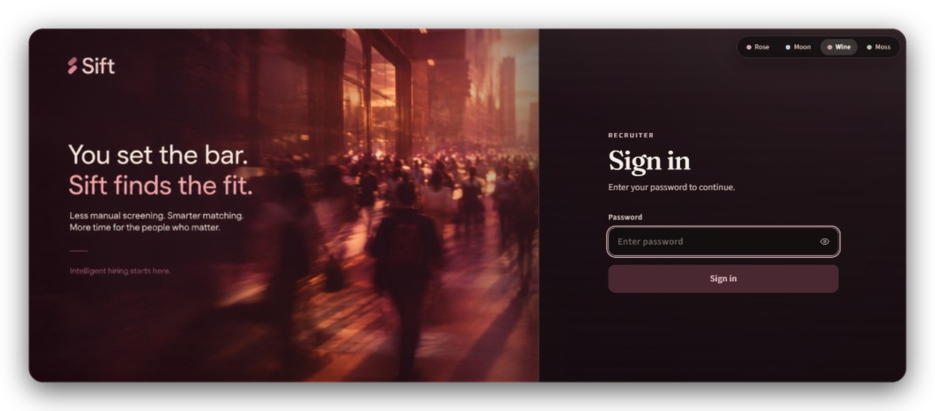
09 · UI DEMONSTRATION
The front door
Recruiter sign in
One password, checked in constant time. The recruiter session is a separate token from any candidate link.
Four themes
The whole desk can be switched to any of them.
Rose
Moon
Wine
Moss
“You set the bar. Sift finds the fit.” · the first screen a recruiter sees
SIFT
13 / 19
Notes:
This is where a recruiter starts: the sign-in page. It checks one password in constant time and issues a recruiter token that is separate from candidate invite links. The theme switcher at the top right changes the whole desk between Rose, Moon, Wine, and Moss.

Slide 14
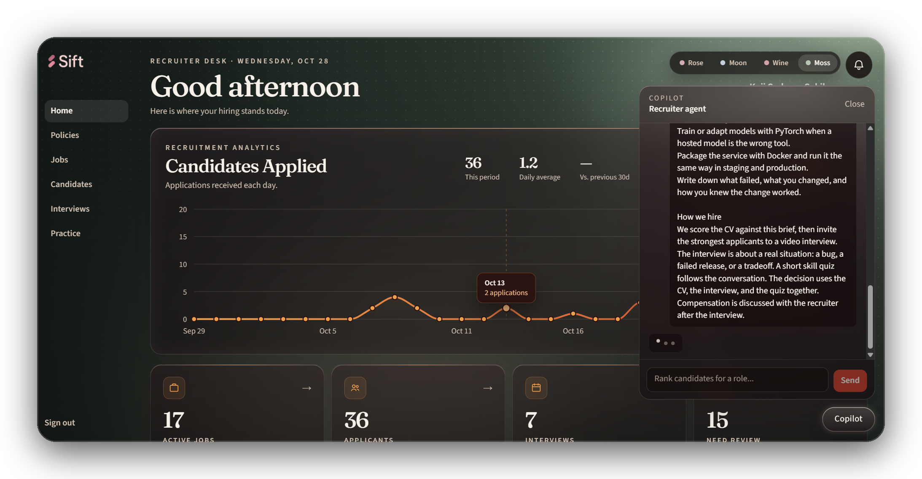
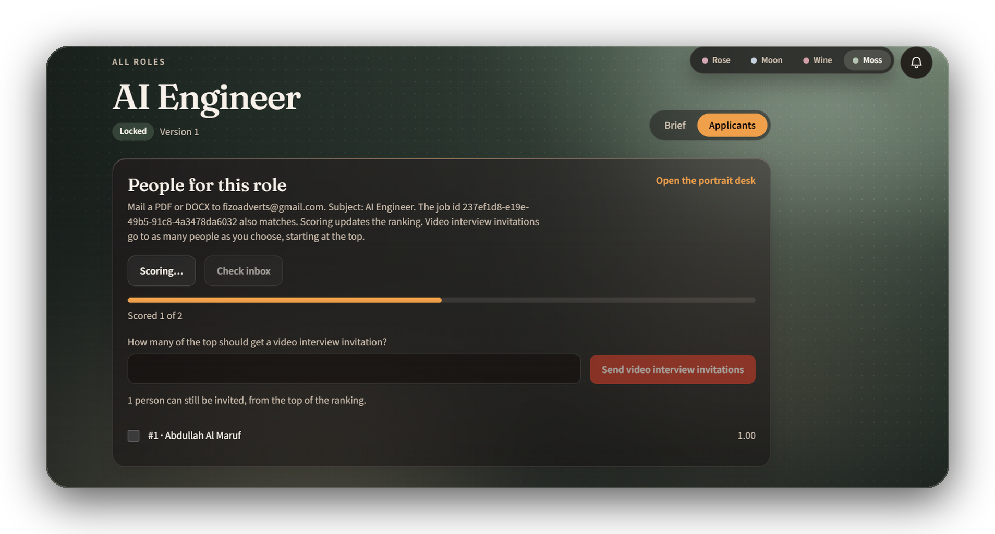
09 · UI DEMONSTRATION
Plan the role, collect the people
Recruiter desk
Locked role, scoring live
Applications over time, open roles, and the copilot writing a role brief from company policy.
CVs arrive by upload or email and are scored one by one. The recruiter picks how many to invite.
SIFT
14 / 19
Notes:
Left: the home desk with the copilot drafting a brief. Right: the AI Engineer role is locked, scoring is running, and invitations go to the top of the ranking.

Slide 15
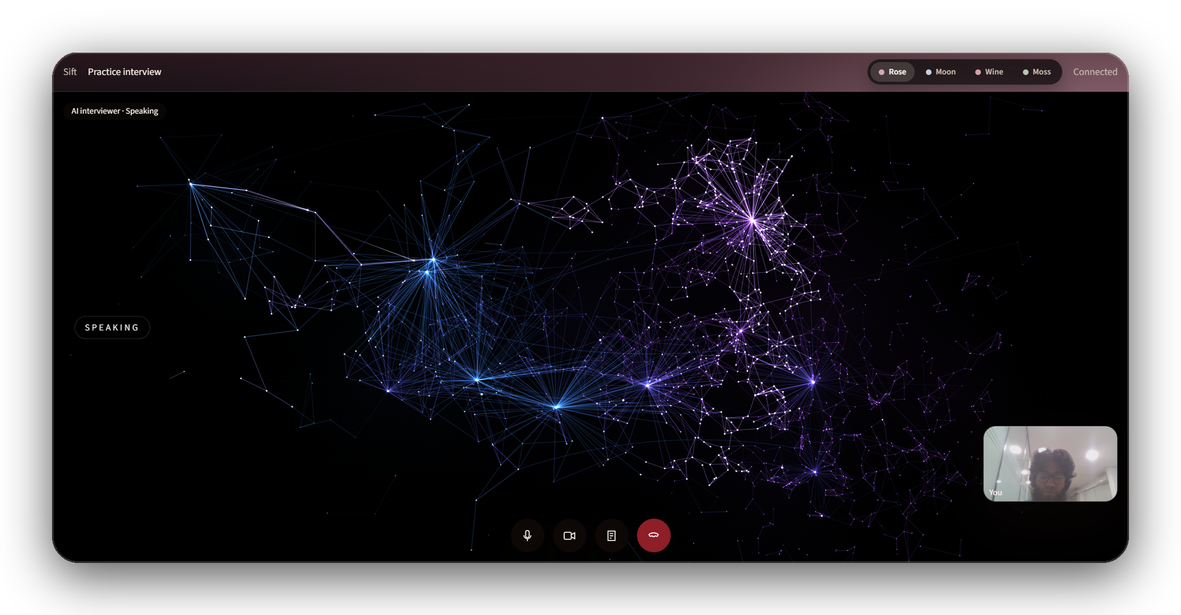
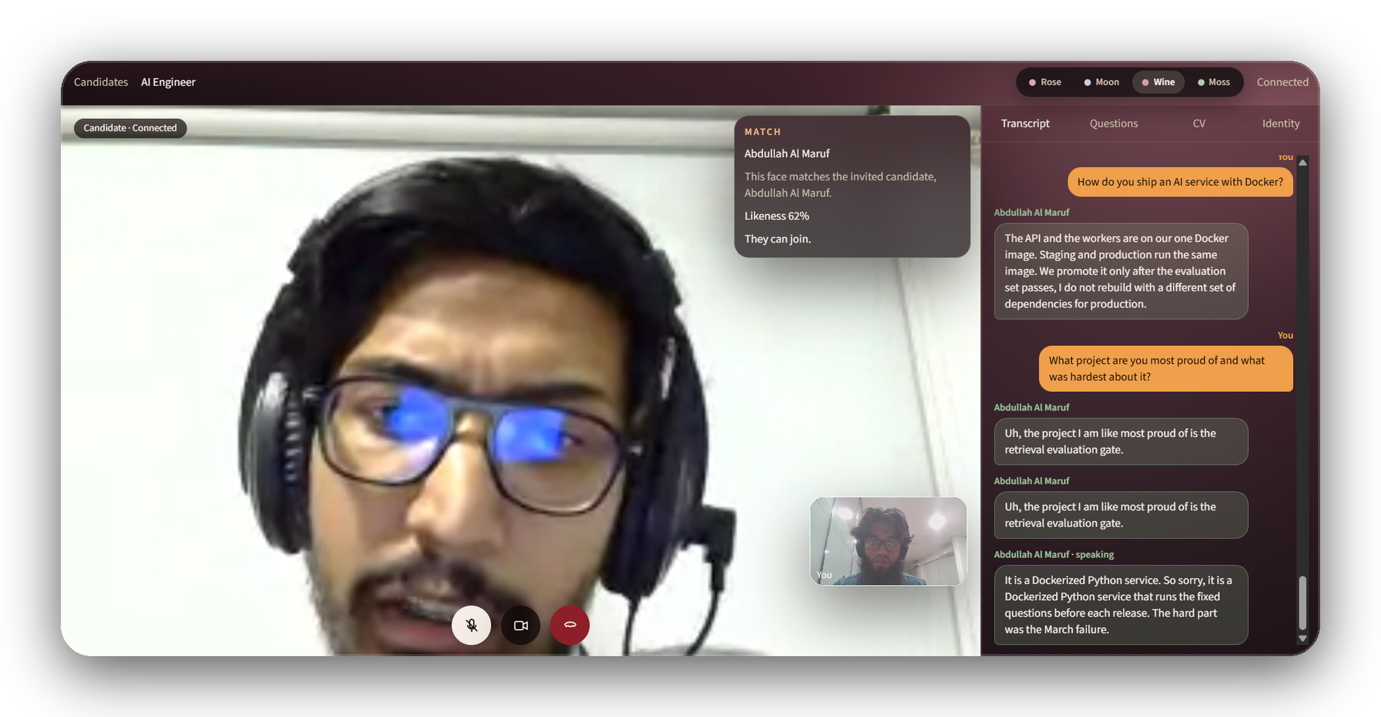
09 · UI DEMONSTRATION
Two ways to interview
AI-LED
The AI interviewer speaks through its neural avatar
RECRUITER-LED
Live transcript with a face match
The candidate joins from their invite link. No recruiter needs to be on the call.
Questions on the right, answers on the left, and the identity card floating over the video.
SIFT
15 / 19
Notes:
Left: the AI-led room, the avatar while speaking. Right: the recruiter-led room with Abdullah Al Maruf, the face match card, and the messenger-style transcript.

Slide 16
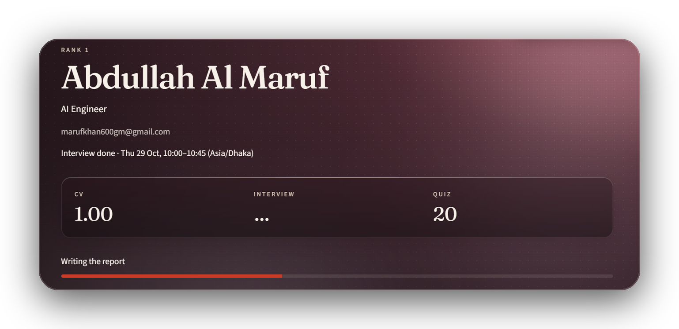
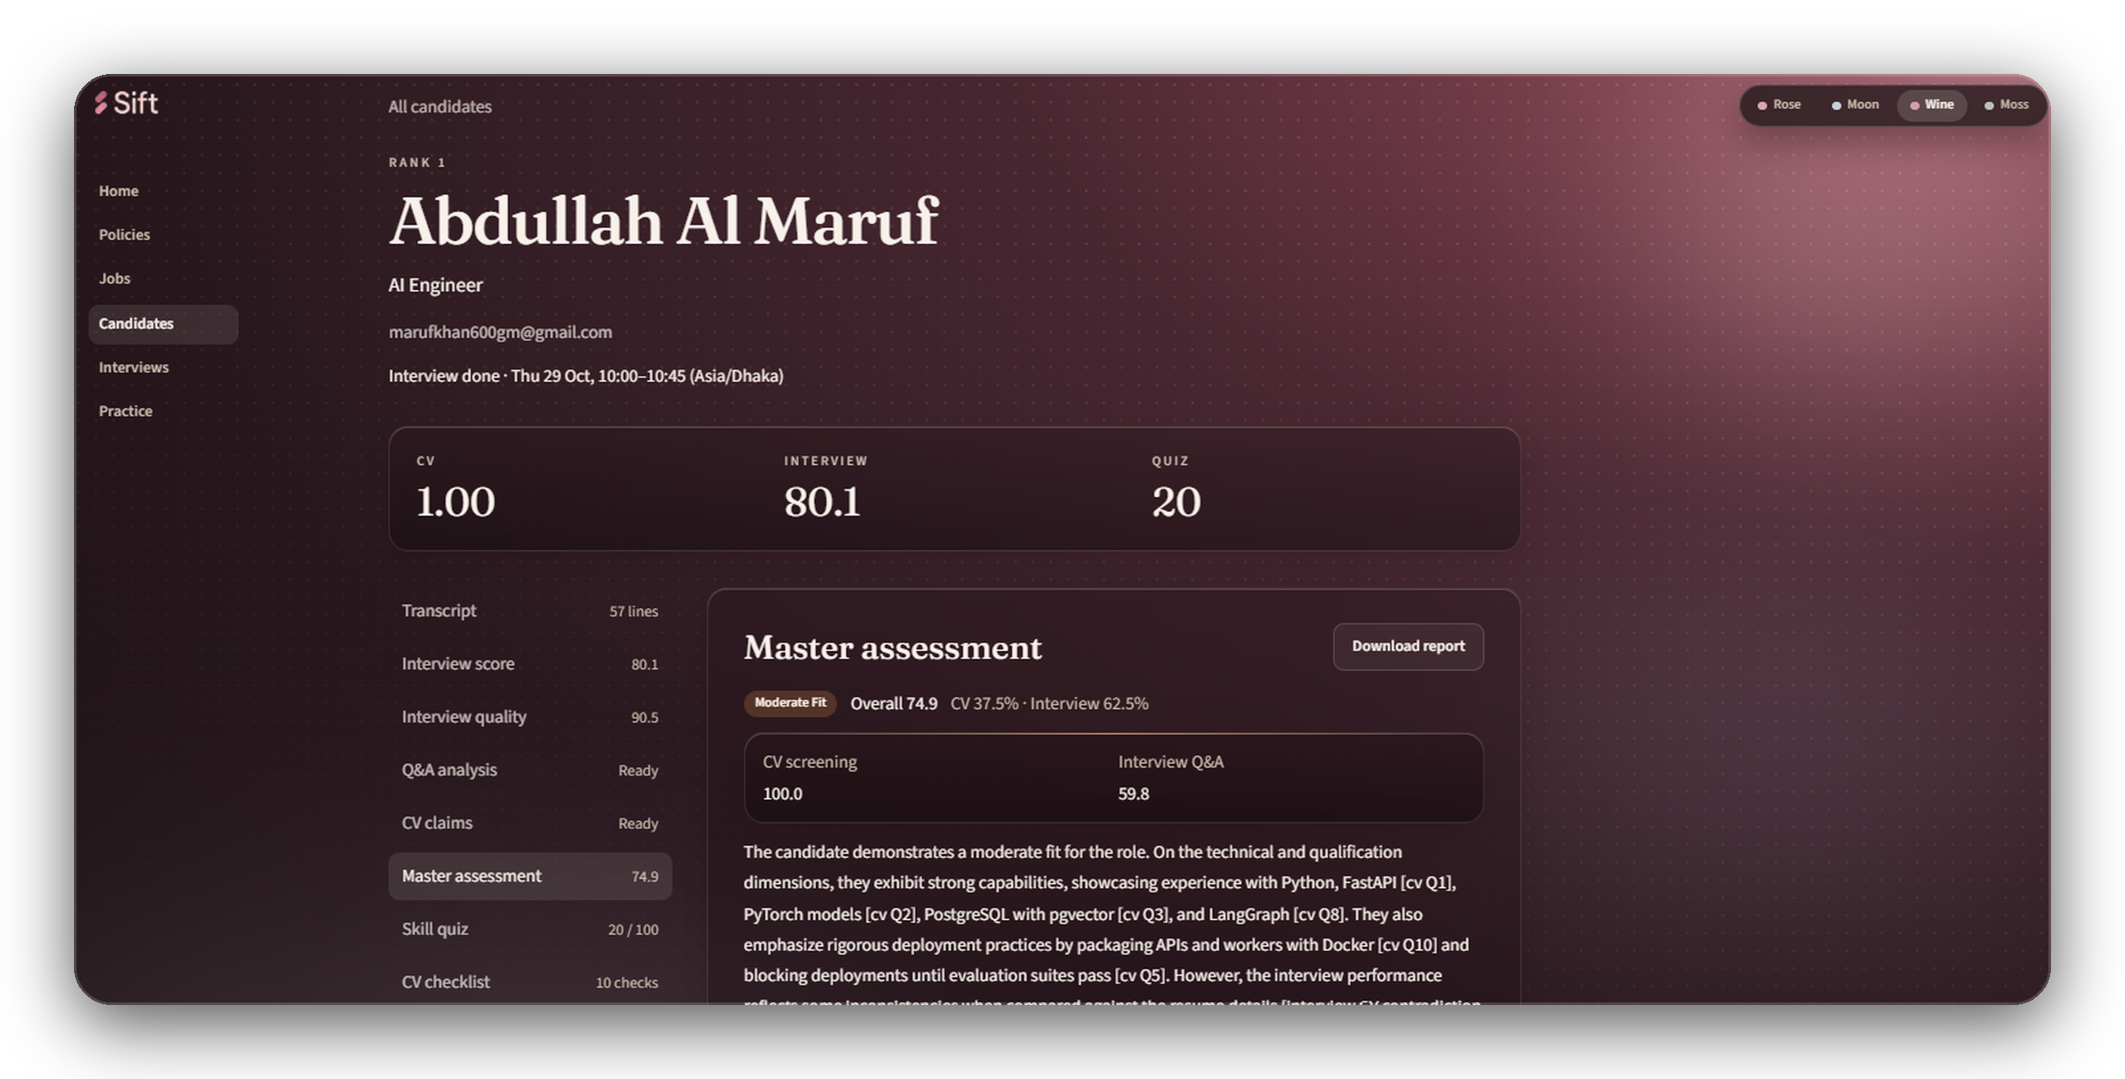
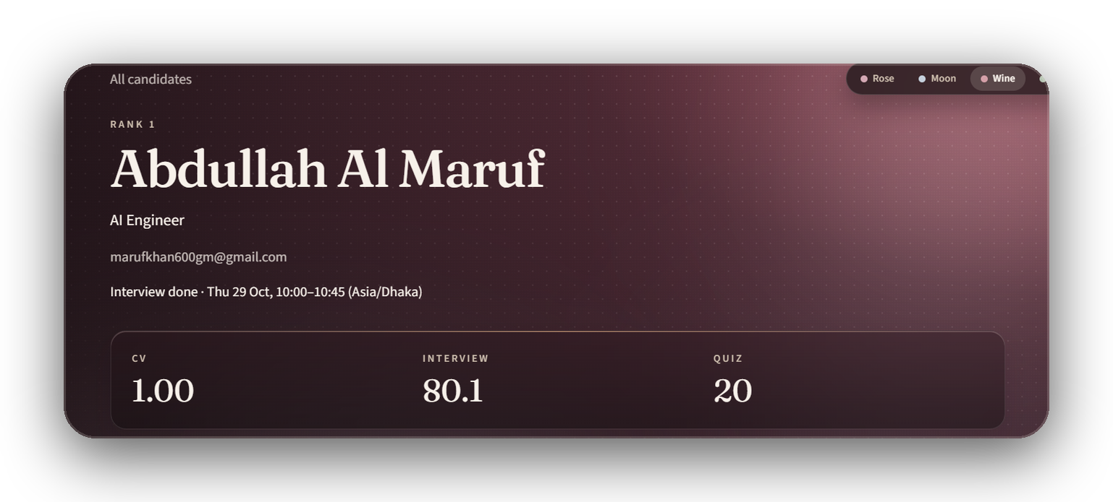
09 · UI DEMONSTRATION
From the call to a decision
1 · The call ends and the report starts writing itself
3 · Master assessment Overall 74.9, Moderate Fit.
Every strength is tied to a checklist item, like [cv Q1], so the recruiter can check the reasoning.
2 · CV, interview, and quiz scores arrive
SIFT
16 / 19
Notes:
These are real results for Abdullah Al Maruf. When the call ends, five reports are written automatically. The master assessment combines CV screening at 100 and interview Q&A at 59.8 into 74.9, and every claim cites the checklist item it comes from.

Slide 17
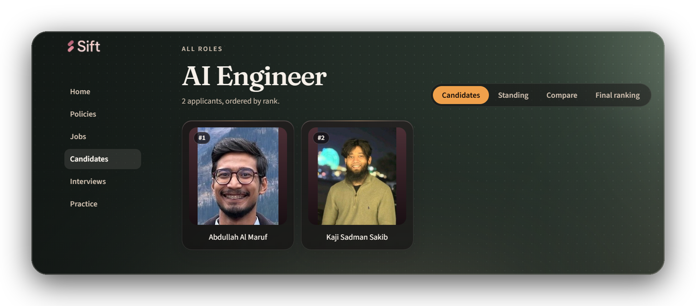
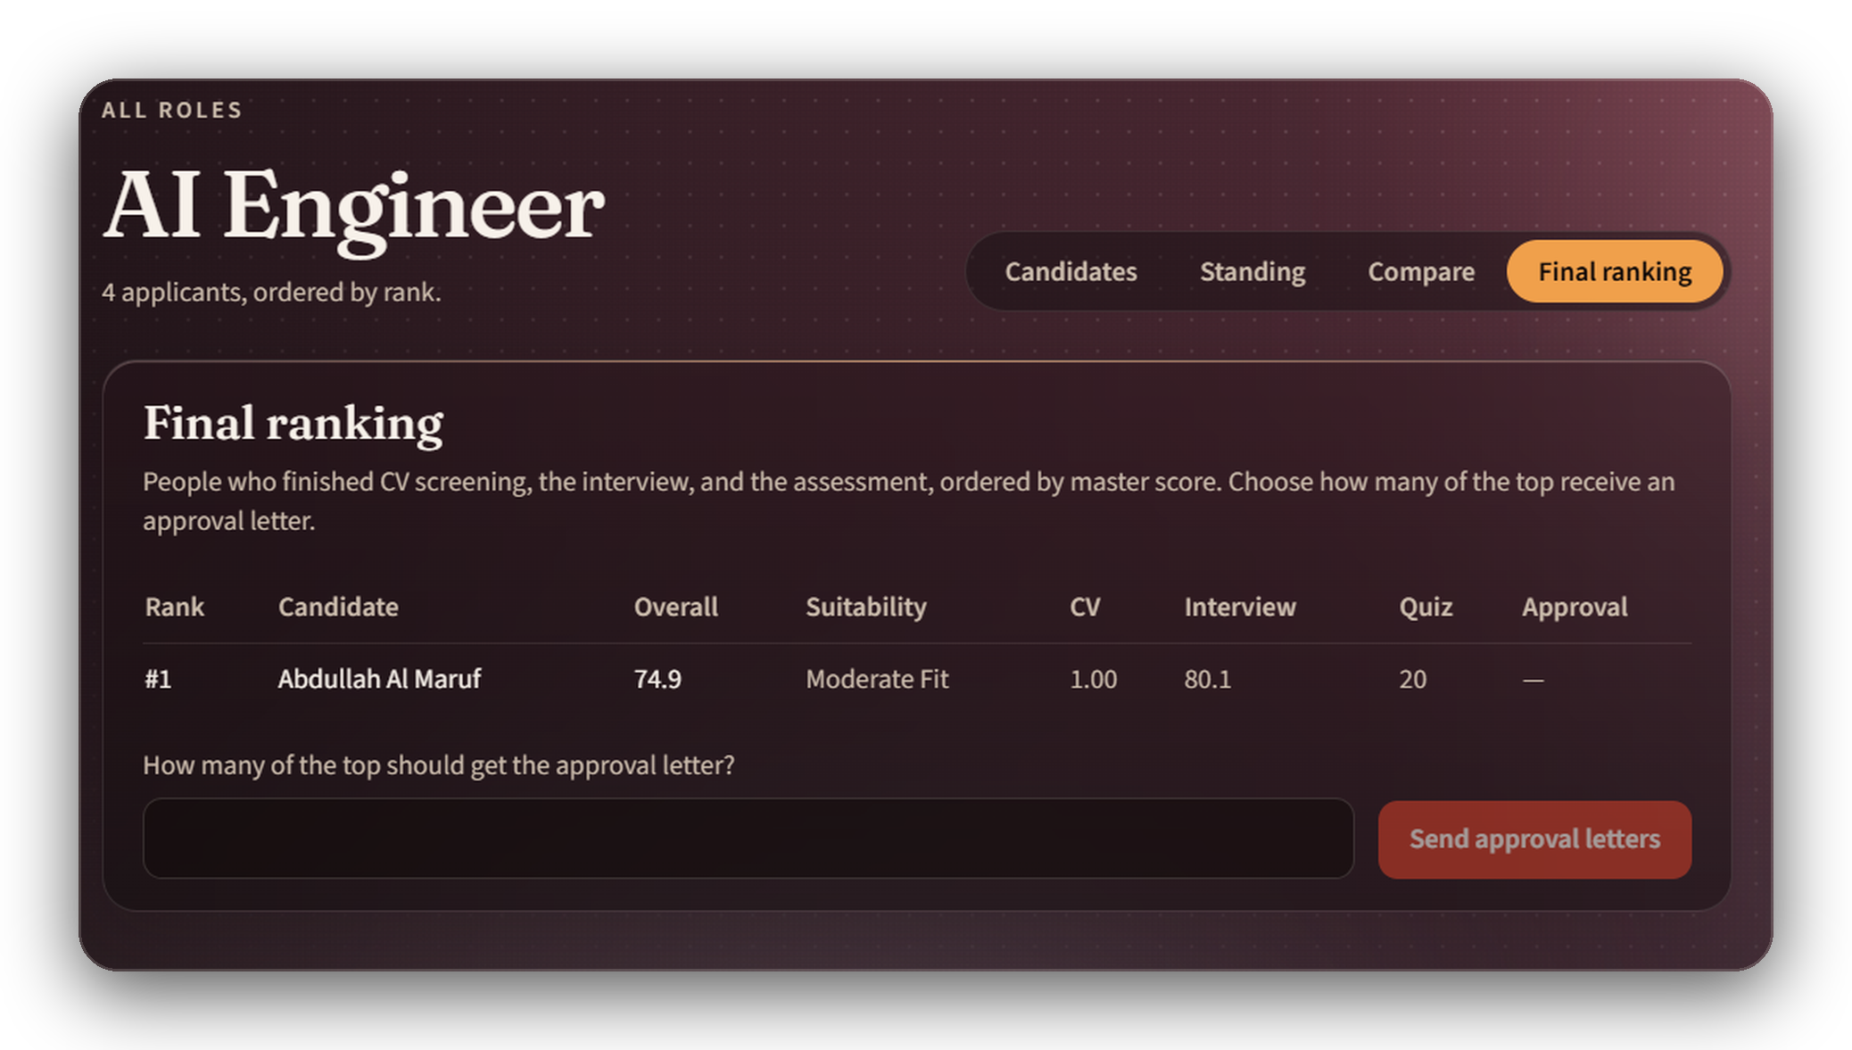
09 · UI DEMONSTRATION
Ranked, explained, ready to approve
Candidates, ordered by rank
Portrait cards from the CV photo, with Standing, Compare, and Final ranking views for the same role.
Final ranking
Only people who finished every stage appear here. The recruiter sends approval letters to the top N.
SIFT
17 / 19
Notes:
The candidate gallery and the final ranking. Final ranking only includes people who completed screening, the interview, and the assessment.

Slide 18
10 · CHALLENGES AND SOLUTIONS
What broke, and how it was fixed
The AI interviewer cut candidates off
Live replies have to feel instant
Problem Its own voice leaked back through the microphone and ended the turn.
Problem A language model can take seconds, or hit a rate limit mid-call.
Solution Mic audio is dropped while it speaks. A turn ends only after 4 seconds of real silence.
Solution A hedged request with a 5-second cap, a short acknowledgement, and a checklist fallback.
One AI provider is a single point of failure
Remote candidates could not reach the app
Problem Quota or outage would stop scoring and reports.
Problem The private address did not resolve on the public internet.
Solution One router: Claude, then Gemini, then a local Ollama model.
Solution Tailscale Funnel gives public HTTPS, with the API served from the same origin.
Checking identity without being invasive
Reports that sound right but are not
Problem A face check has to be fair and optional for the recruiter.
Problem A model summary can invent strengths.
Solution Explicit consent, three-frame InsightFace match, and a recruiter override.
Solution Every claim cites a checklist item, and scores come from the saved transcript.
SIFT
18 / 19
Notes:
Six real problems hit while building and testing Sift, each with the fix that is in the code today.

Slide 19

11 · Q&A
Questions?
Thank you for listening.
SIFT
19 / 19
Notes:
Open the floor. Likely questions: how the AI interviewer decides what to ask, how face data is stored and consented, what happens when the AI provider fails, and how the final score is weighted.

